Slide 1

Presentation to Chino Valley Town Council – Tuesday, May 14, 2014
Thank you for this opportunity
The Mission of the Chino Valley Area Chamber of Commerce & Visitor Information Center is to Support, Promote, and Provide Resources for the Chino Valley Area.
The Vision of the Chino Valley Area Chamber of Commerce is to be Chino Valley’s Premier Business Networking & advocacy Organization

Slide 2

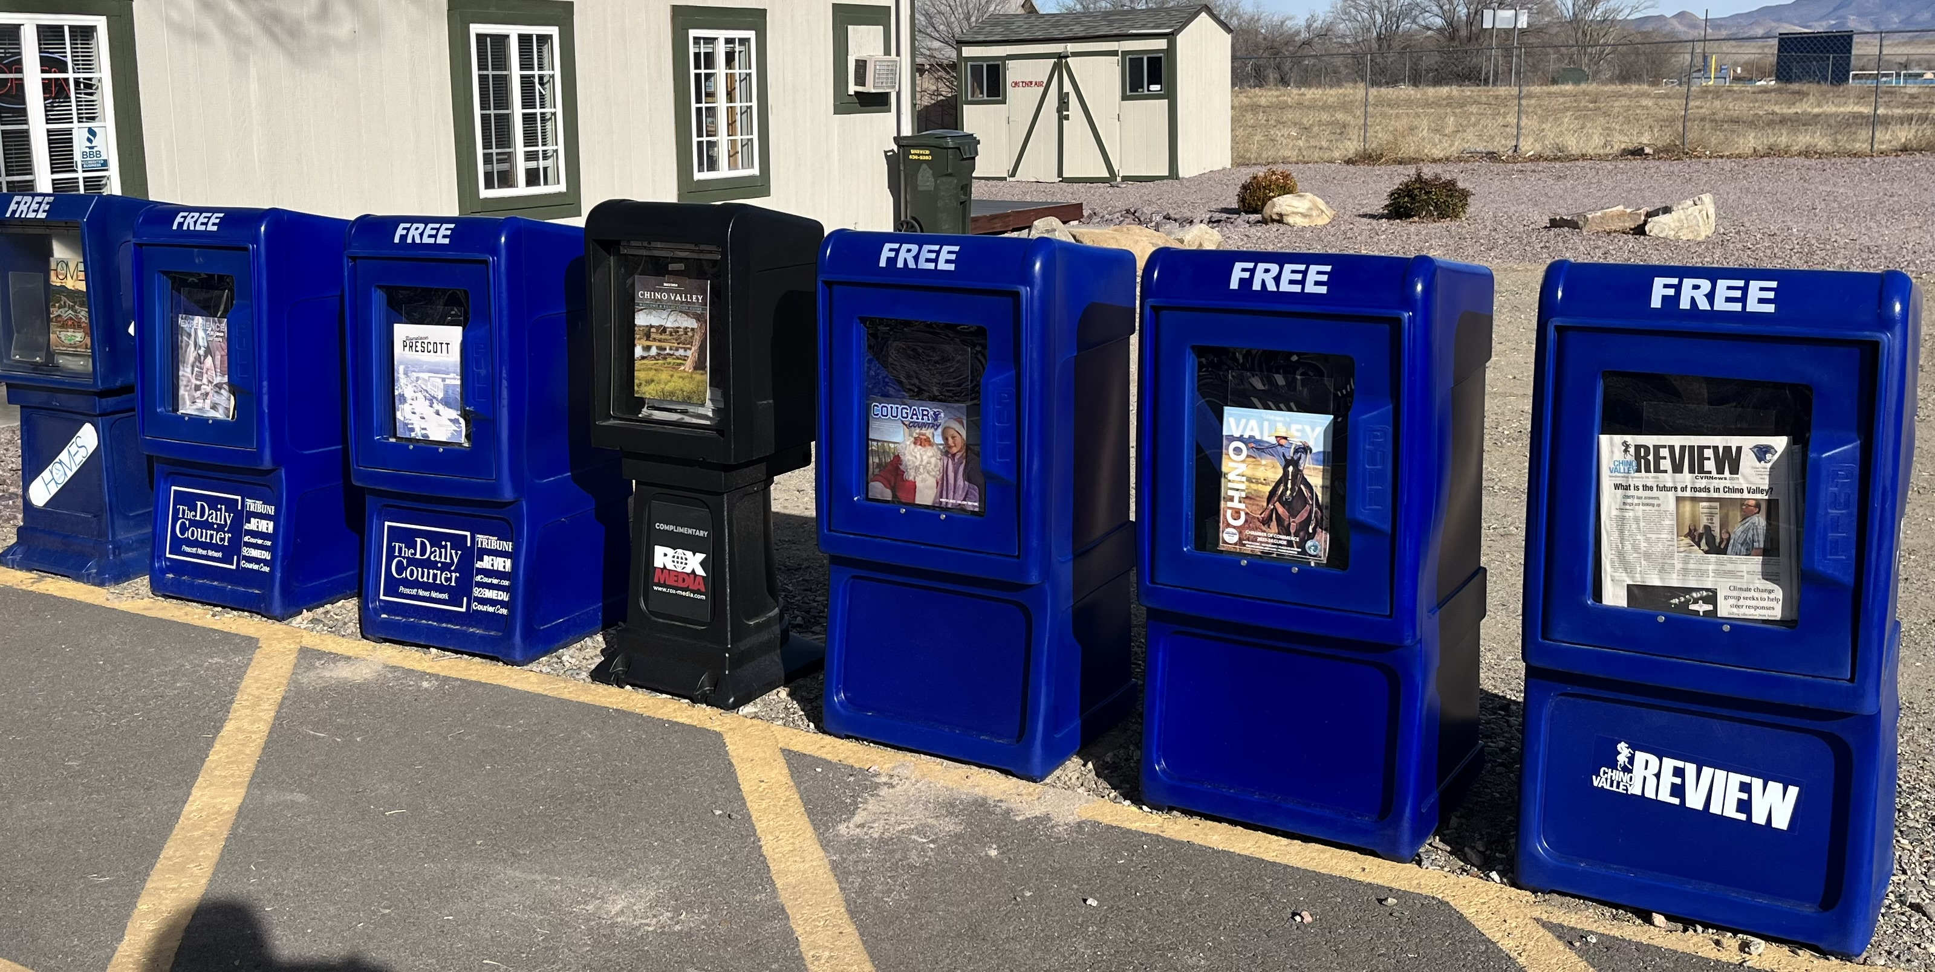


Presentation to Chino Valley Town Council – Tuesday, May 14, 2024
PROMOTION OF TOWN & CHAMBER PARTNERS

Slide 3
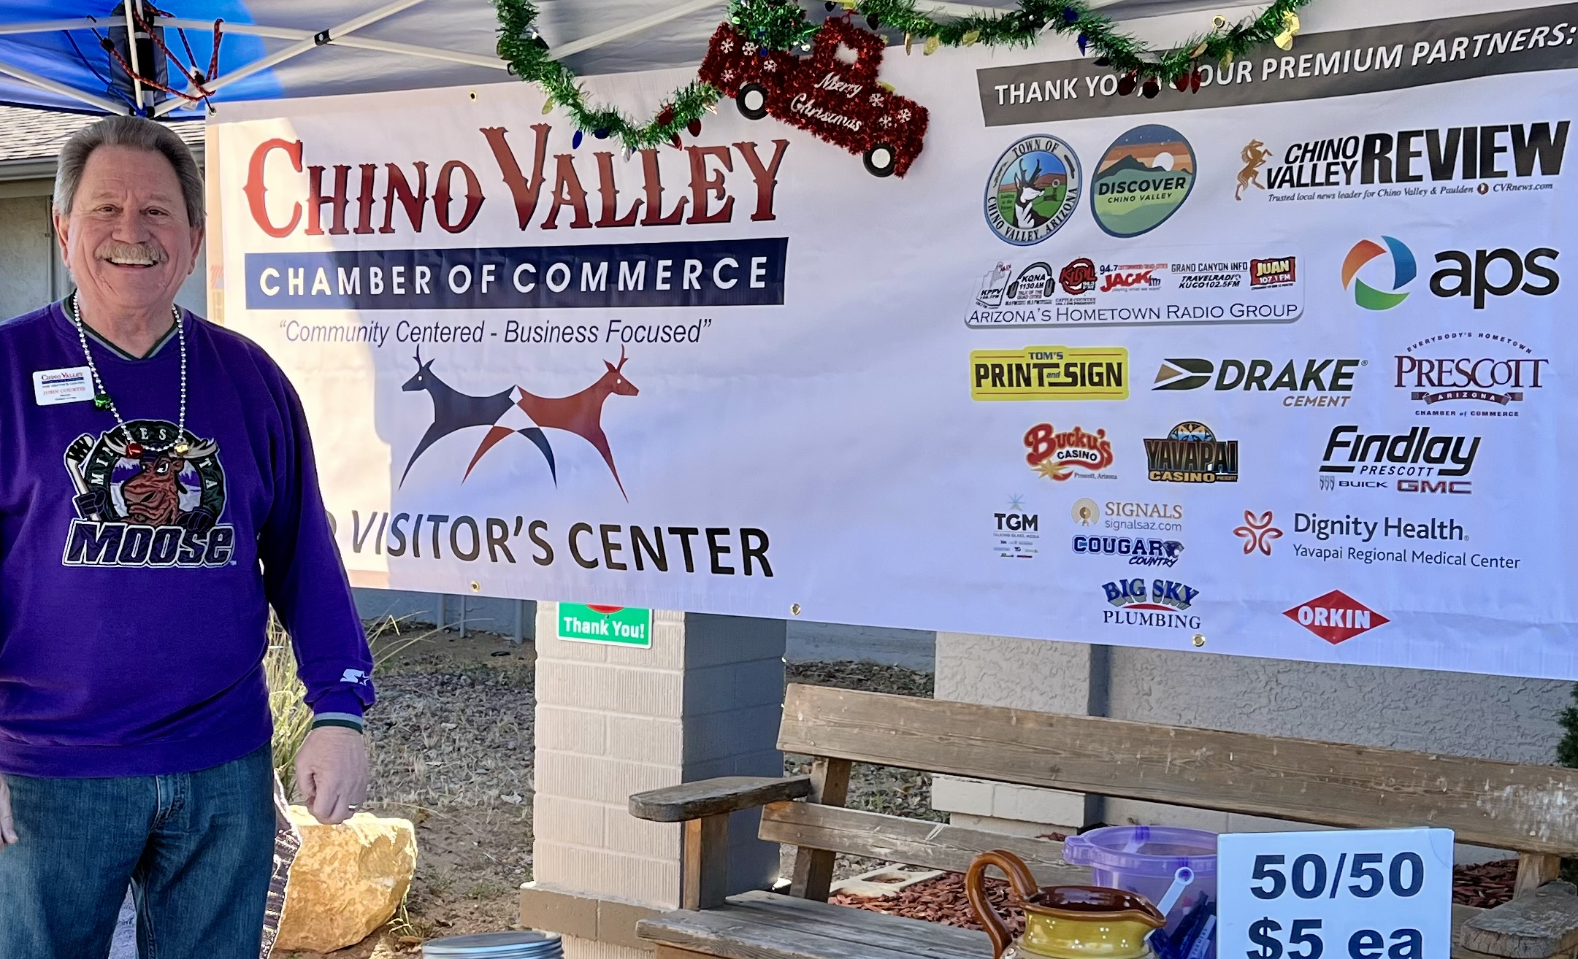
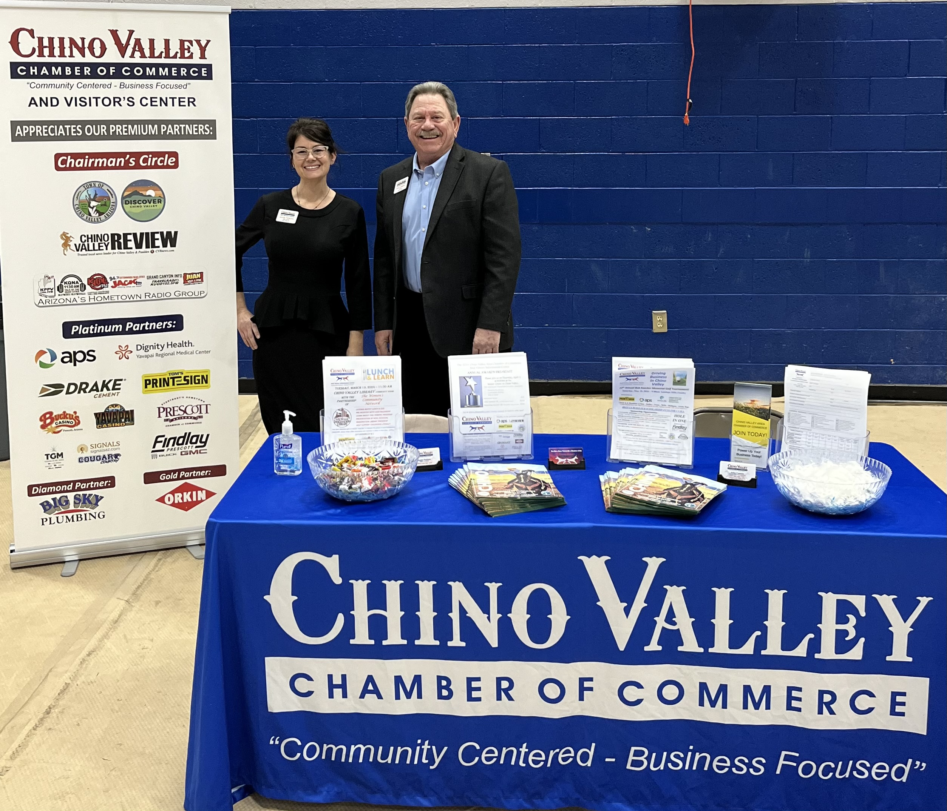
Presentation to Chino Valley Town Council – Tuesday, May 14, 2024
ACTIVITIES TO SUPPORT CHINO VALLEY
TOWN & LOCAL BUSINESSES
- 11 Ribbon Cuttings
- 1 Groundbreaking
- 7 Lunch & learn
- 2 ‘Business After Hours’
- Territorial Days Parade
- YC Job Fair
- SIX $500 CVHS Scholarships
Shop Local Saturday
Chino Grinder Bike Race
Hwy 89 Holiday Lighting
Yavapai College Harvest Fest
National Nite Out
From 7:00am to lunch at 1:00.

Slide 4
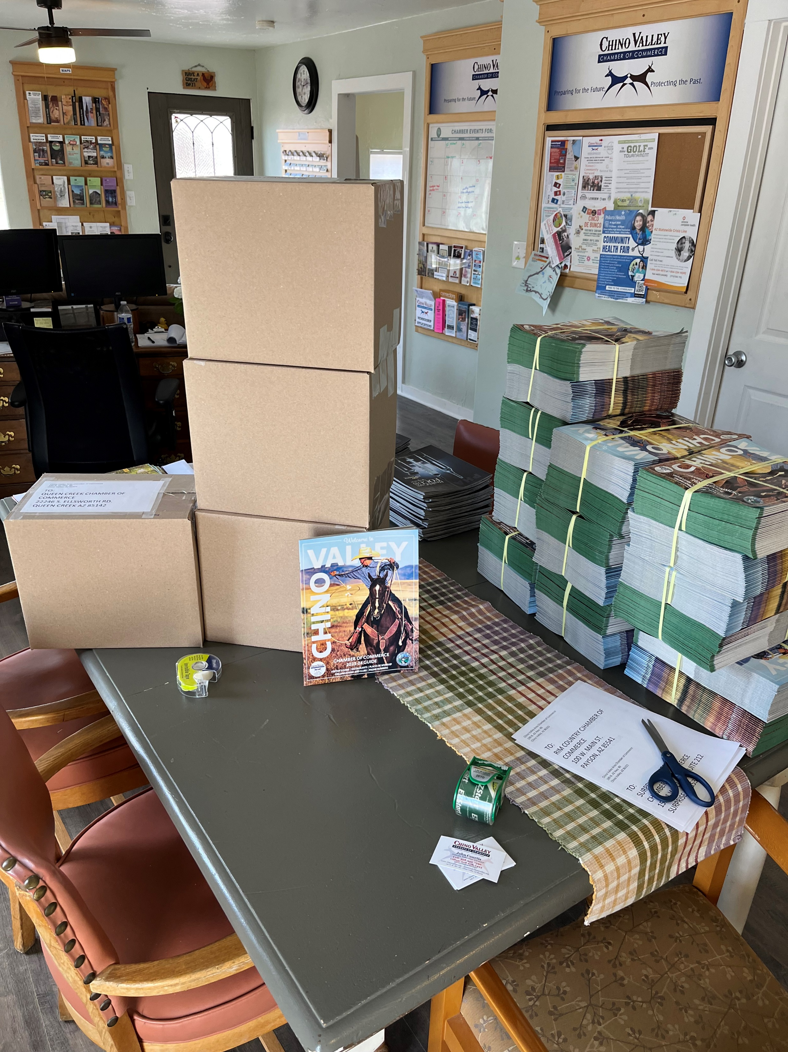
Presentation to Chino Valley Town Council – Tuesday May 14, 2024
PROMOTION AS THE TOWN’S VISITOR INFORMATION CENTER
The Chino Valley Visitor’s Guide & Relocation Magazine Is in 30 Centers
Buckeye Goodyear Scottsdale
Bullhead City Kingman Sedona
Camp Verde Lake Havasu Sierra Vista
Casa Grande Marana Surprise
Chandler Mesa Tempe
Cottonwood Nogales Phoenix
Flagstaff Payson Prescott
Florence Peoria Prescott Valley
Gilbert Queen Creek Williams
Glendale CHINO VALLEY Yuma
OTHER NOTE:
Mailed out ‘Relocation Packages’ In-State 7 – Out of State 29
Might get ‘rizona Tourist Information Sign moved soon!

