Slide 1


Slide 2
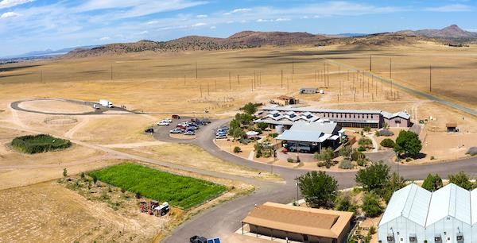
WHAT PEOPLE DON’T KNOW….
…THE DIAMOND IN THE ROUGH

Slide 3
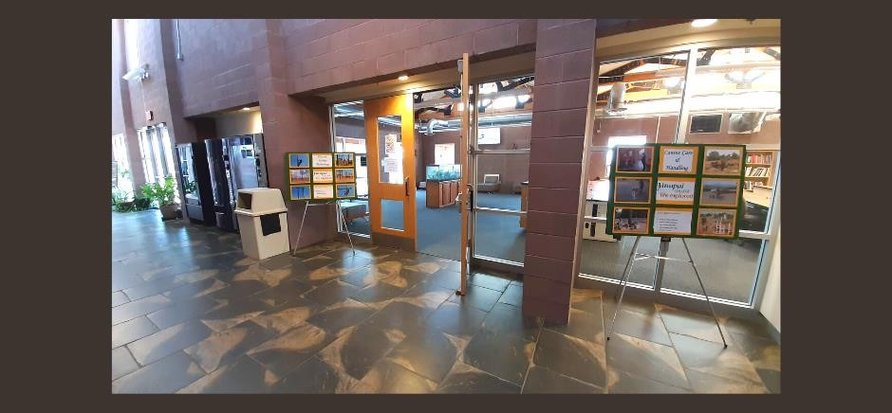
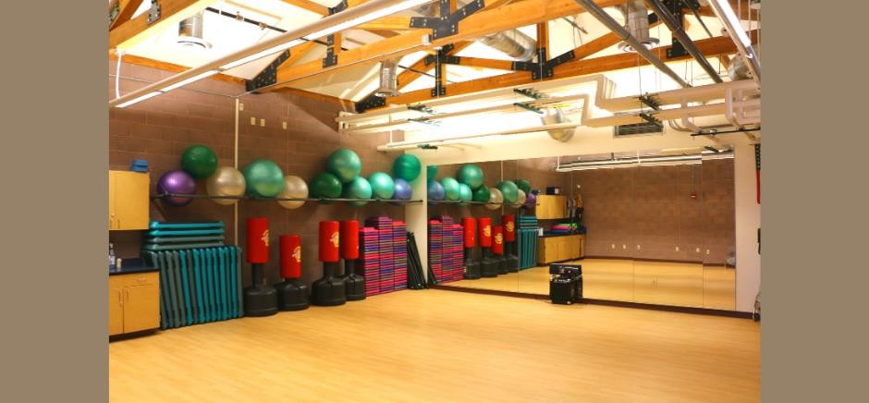
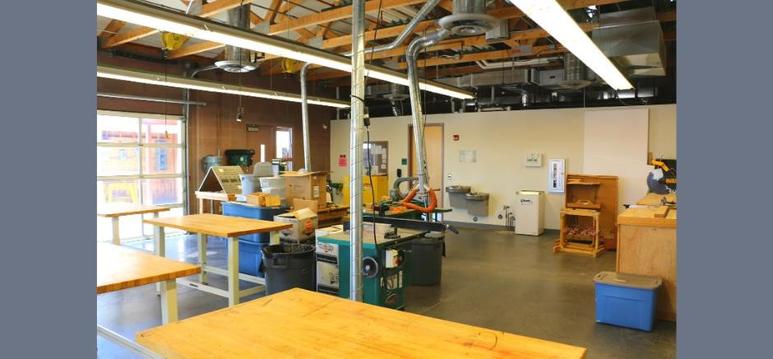
ALL THINGS AWESOME
RELATIONSHIP EXCELLENCE
KNOWLEDGEABLE & FRIENDLY STAFF
PROFESSIONALS IN THE FIELD ONE STOP SHOP
SERVICE EXCELLENCE
STUDENT SUPPORT SERVICES
STUDENT LOUNGE COMPUTER COMMONS
LEARNING EXCELLENCE
LARGE HANDS-ON LABS
INDUSTRY STANDARDS
JOB PLACEMENT/APPRENTICESHIPS

Slide 4
AGRICULTURE TECHNOLOGY MANAGEMENT, AAS DEGREE
Agriculture Technology Management, Certificate
Animal Care and Management, Certificate
Production Horticulture, Certificate
AGS

Slide 5
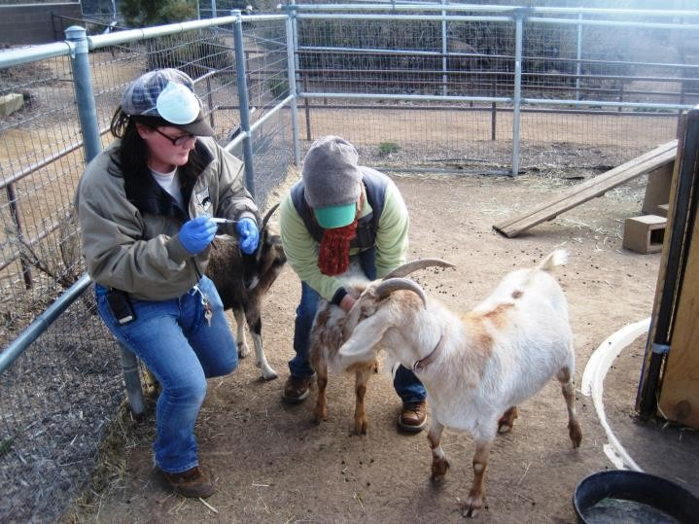
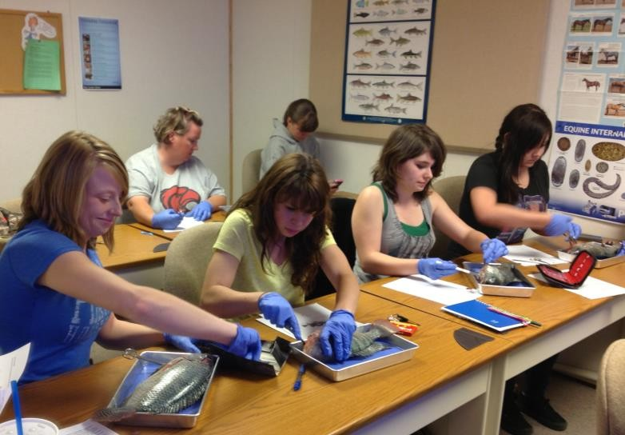
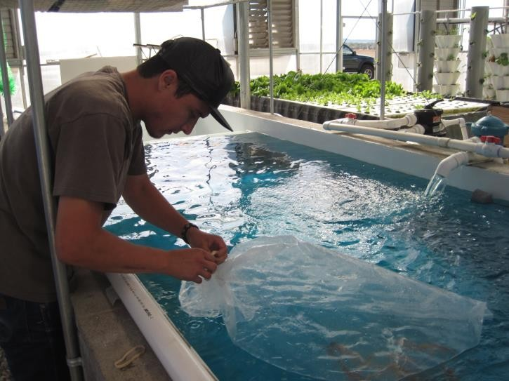
ANIMAL CARE AND MANAGEMENT
AGS

Slide 6
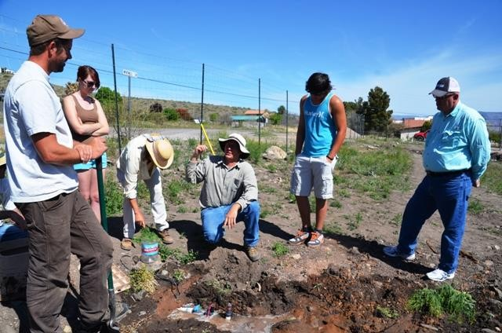
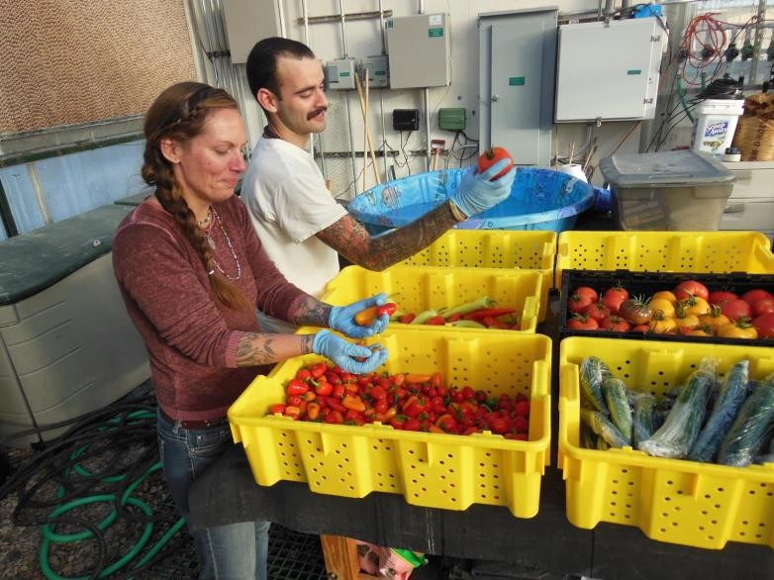
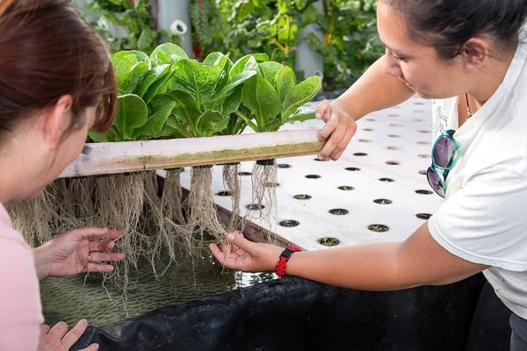
PRODUCTION HORTICULTURE
AGS

Slide 7
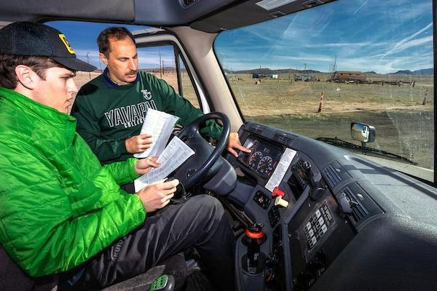
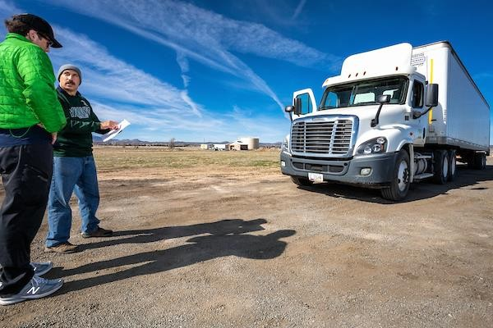
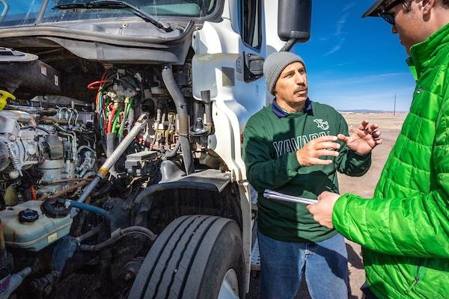
COMMERCIAL DRIVER TRAINING
CDT

Slide 8
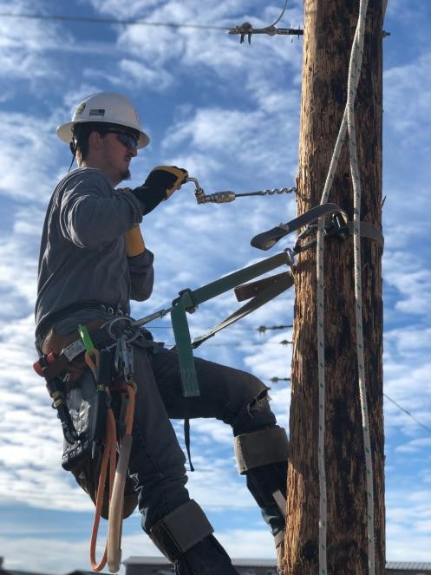
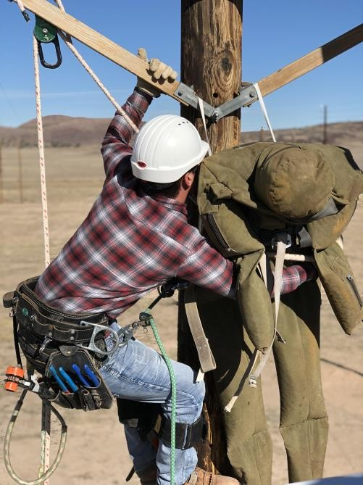
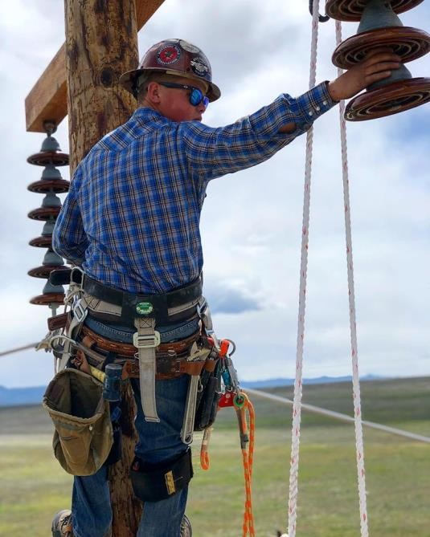
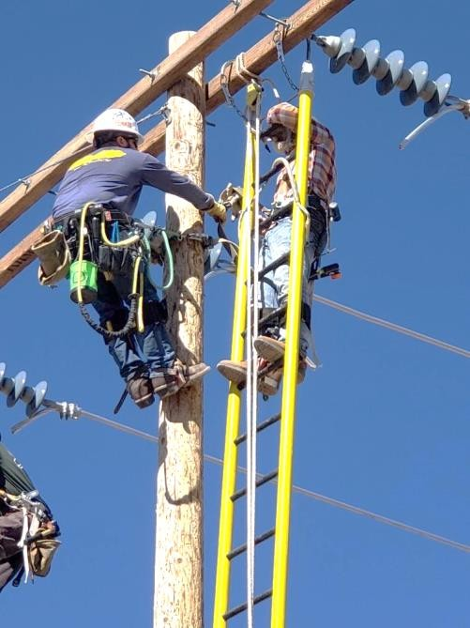
ELECTRIC UTILITY TECHNOLOGY - LINEWORK
EUT

Slide 9
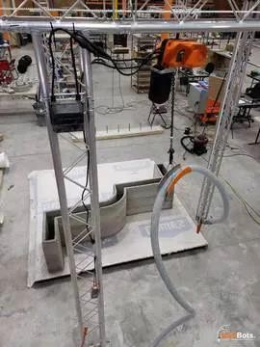
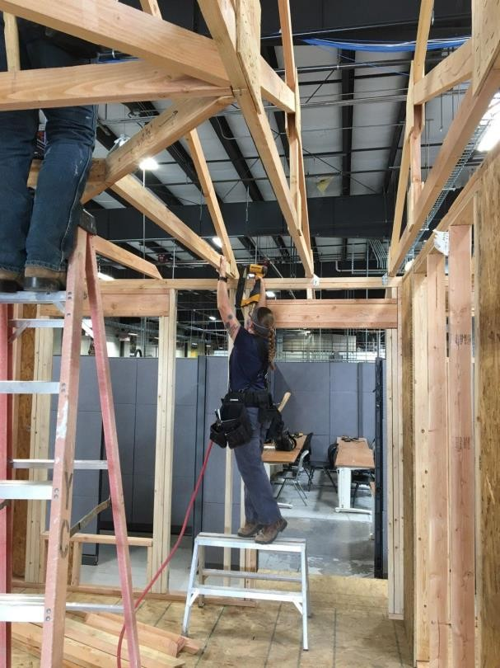
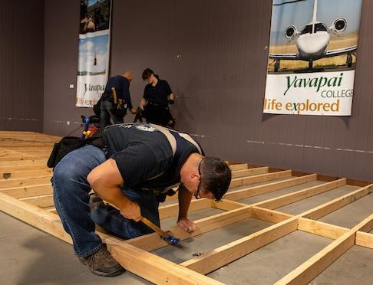
CONSTRUCTION BUILDING TECHNOLOGY
CBT

Slide 10


